Slide 1
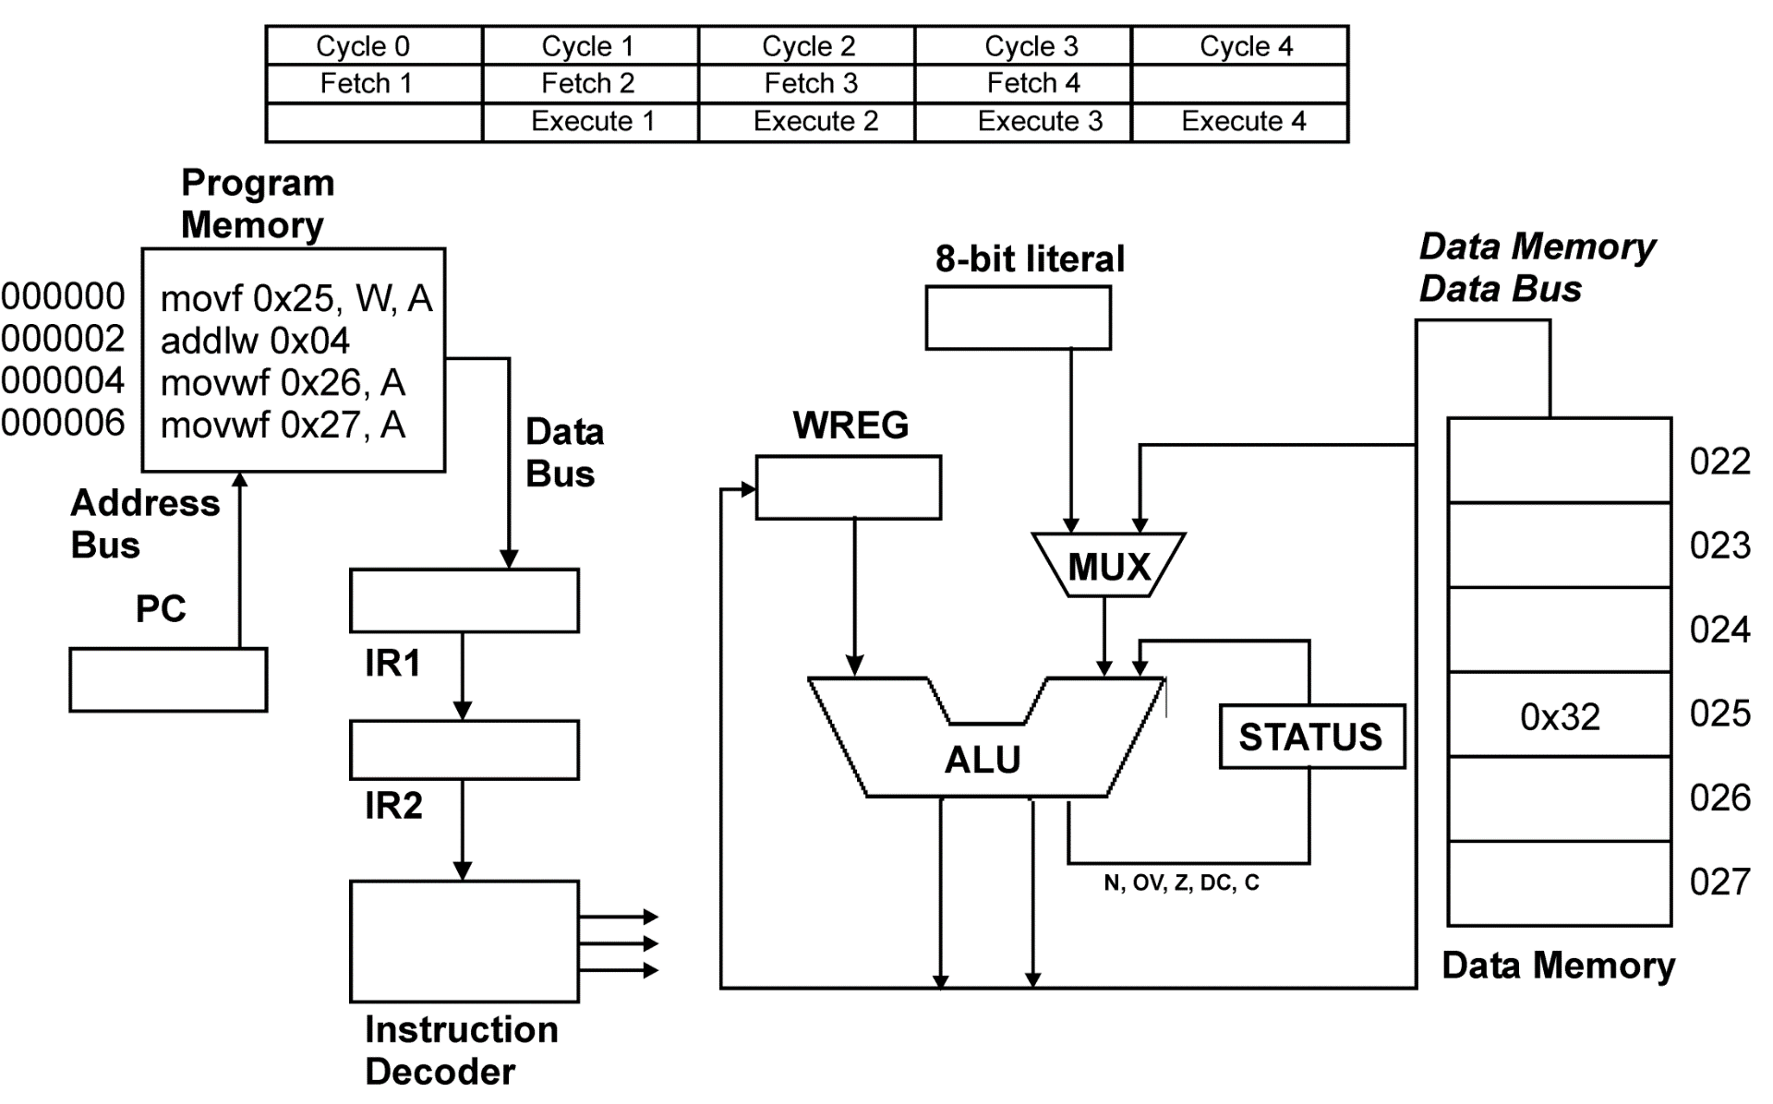
Fetch-And-Execute: A Complete View
Fetch 5
0x04
0x36
0x36
addlw 0x04
5th inst.
movwf 0x26, A
movf 0x25, W, A
movwf 0x27, A
0x32
0x04
00000A
000008
000000
000002
000004
000006
0x32
0x32
0x36
0x36
0x36
Decode
Decode
Decode

